Slide 1


Slide 2

Project Title : SORTING OF PRODUCT BASED ON COLOR AND WEIGHT VIA SMART SYSTEM
Computing Department, FCIT
BSCS 7th
Supervisor Name :
Chairperson , HOD
Dr. Zahoor Hussain Shah
Lecturer , Head of FYP
Shagufta Aftab
Group Members:
Rimsha Pervaiz (1307-2018)
Aisha Tabbassum (1318-2018)

Slide 3
Contents of Presentation

Slide 4
Introduction
Problem Statement
Literature Review
Architecture diagram
GUI Video
Prototype Module
References

Slide 5
Introduction

Slide 6
This is the time of globalization and we here tend to solve the problem for mainly packaging industries as well as the supermarkets.
Here we are introducing a prototype model of product sorting machine which sort products based on their weight and color.
The main objective of this project is to propose an smarter, intelligent and cost-effective object sorting system which categorizes the objects based on their respective color and will place them at their designated locations to minimize the cost and optimize the productivity.

Slide 7
Problem Statement

Slide 8
Based on a survey conducted in different industries and manufacturing companies, there was a problem regarding the count of the total manufactured products and also, there were various assembly lines for every different product based on their weight and color.
In a food packaging industry huge amount of time and labor was invested in segregating raw and ripened fruits. When these food packaging industries adopt object sorting machine they would decrease the time, work space and labor cost while providing the basic function.
Object sorting is a very common industrial application but at the same time it is a tiresome process as handling so many objects is a menial task which is not so promising in maintaining consistency and thereby arising quality issues.

Slide 9
Literature Review Given below table shows the existing work;

Slide 10
RESEACRCH TITLE | YEAR | PROPOSED BY | FEATURES OF PROPOSED TECHNIQUE
IoT based sorting system of consumer goods production | 2021 | S Syufrijal, M Rif'an, A W R Prabumenang, R Wicaksono, AA Maqfiroh and R F Ilhami | The purpose of this research is to make a tool that can sort goods automatically into the warehouse using RFID by combining Arduino and PLC as the controller.
Automate Fruits Sorting Machine | 2020 | Dhroov batra, Hardik Riwari, Hema N | In this work, we introduce better quality sorting of fruits based on color to meet the market standards.
UNIQUENESS OF OUR SYSTEM
Our system can not only sort products based on color but also based on weight and can count and display the quantity of products.
There are some fruits which are different in quality but are of same color, but our system can also sort these kinds of fruits using there weight.

Slide 11
RESEACRCH TITLE | YEAR | PROPOSED BY | FEATURES OF PROPOSED TECHNIQUE
Color Detection of marbles Using Internet of Things Machine | 2019 | Prince Mary, S. Lakhsmi, Sareddi Vijaya, Anuhya Seemakurty | This published work gives color sorting mechanism to sort different marbles based on color.
Sensor based Color Sorting Robot for Candy Manufacturing | 2018 | S. Krishnakumar¹, K. Sneha¹ and A. Reethika² | In this work color sorting of candy is done by detecting color and the edges of given image which are of similar colors.
UNIQUENESS OF OUR SYSTEM
There are various types of marbles, tiles but some of them are of same color, which can be sorted by out system as its is also based on weight.
Existing work can sort based on color of product, but what if candies are of different quality but in same color.

Slide 12
RESEACRCH TITLE | Accuracy % | PROPOSED BY | Accuracy %
Color Detection of marbles Using Internet of Things Machine | [13/20] 65% | Prince Mary, S. Lakhsmi, Sareddi Vijaya, Anuhya Seemakurty | [11/15] 73%
Sensor based Color Sorting Robot for Candy Manufacturing | [18/25] 71% | S. Krishnakumar¹, K. Sneha¹ and A. Reethika² | [15/20] 75%
RESEACRCH TITLE
IoT based sorting system of consumer goods production
Automate Fruits Sorting Machine

Slide 13
Architecture Diagram

Slide 14
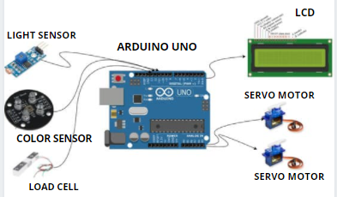

Slide 15
GUI DIAGRAM

Slide 16
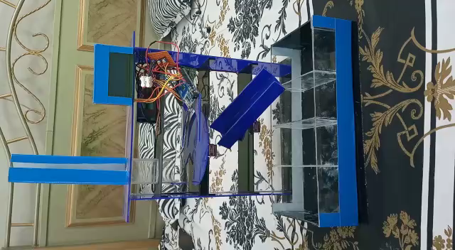

Slide 17
PROTOTYPE MODULE

Slide 18
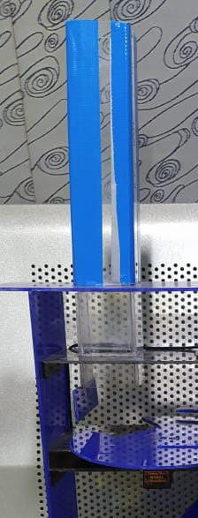
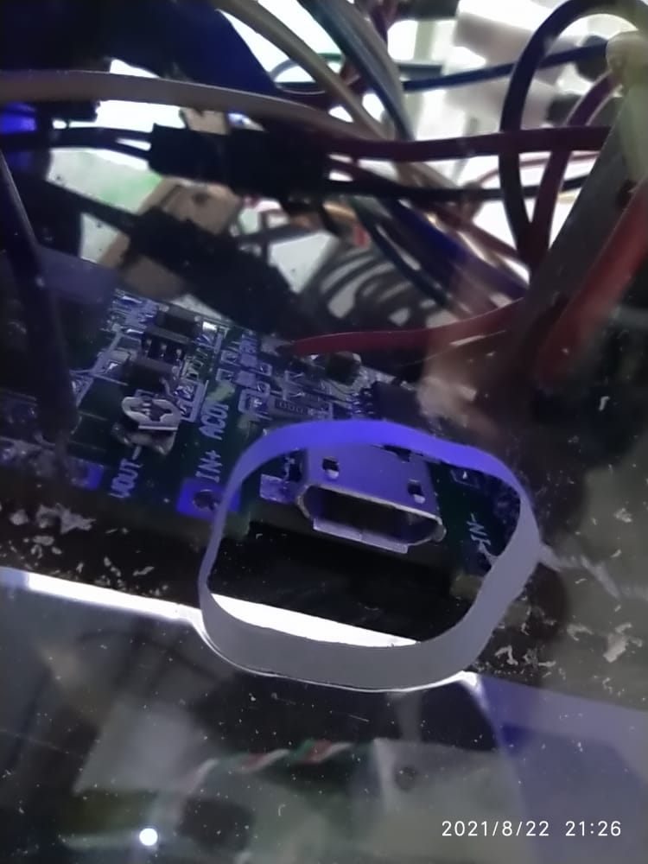
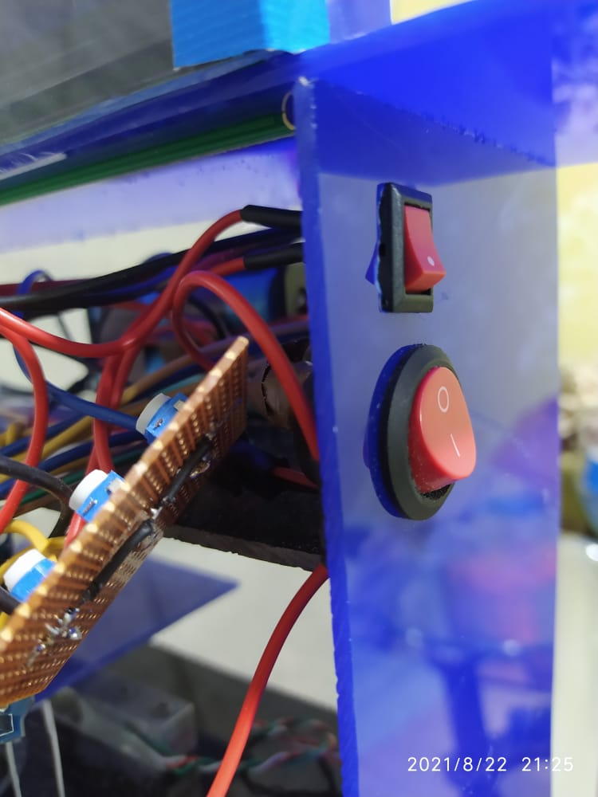
Battery Charger Port
Object Enterance
On/Off Buttons

Slide 19
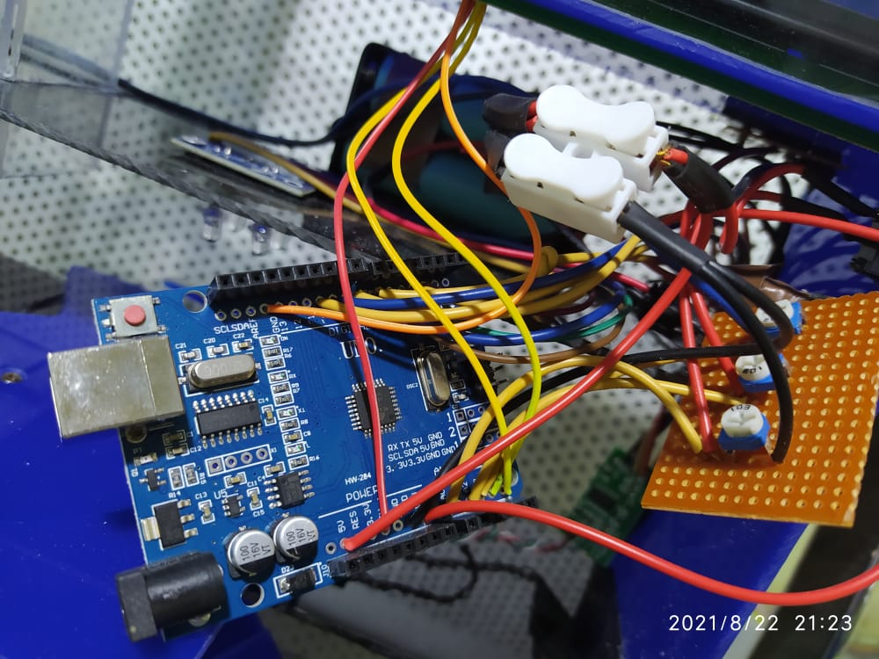
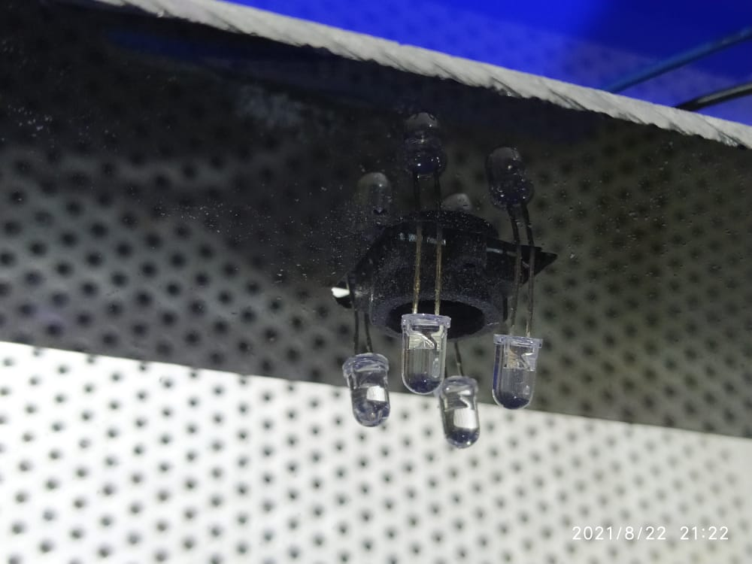
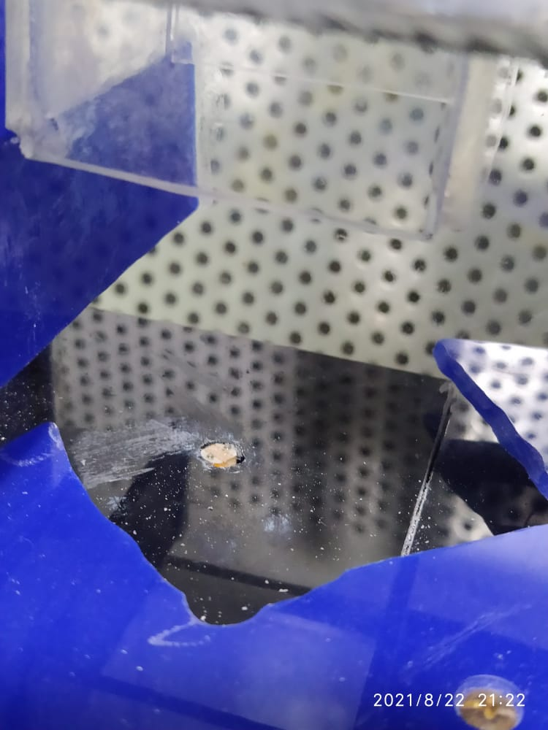
Arduino Nano
Color Sensor
Weight and Count sensor

Slide 20
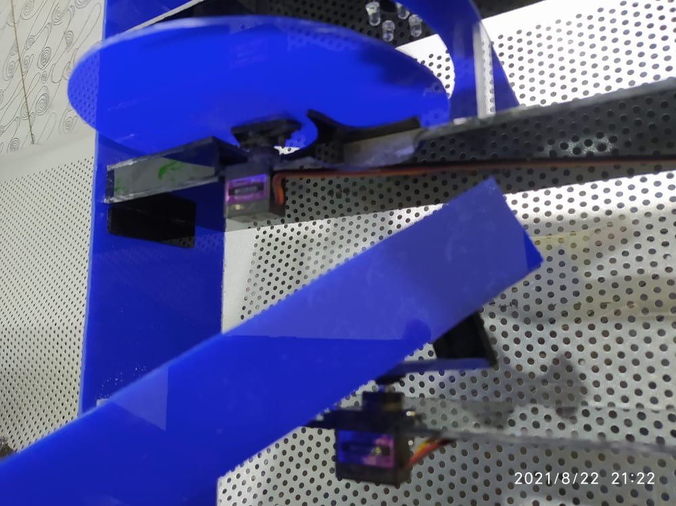
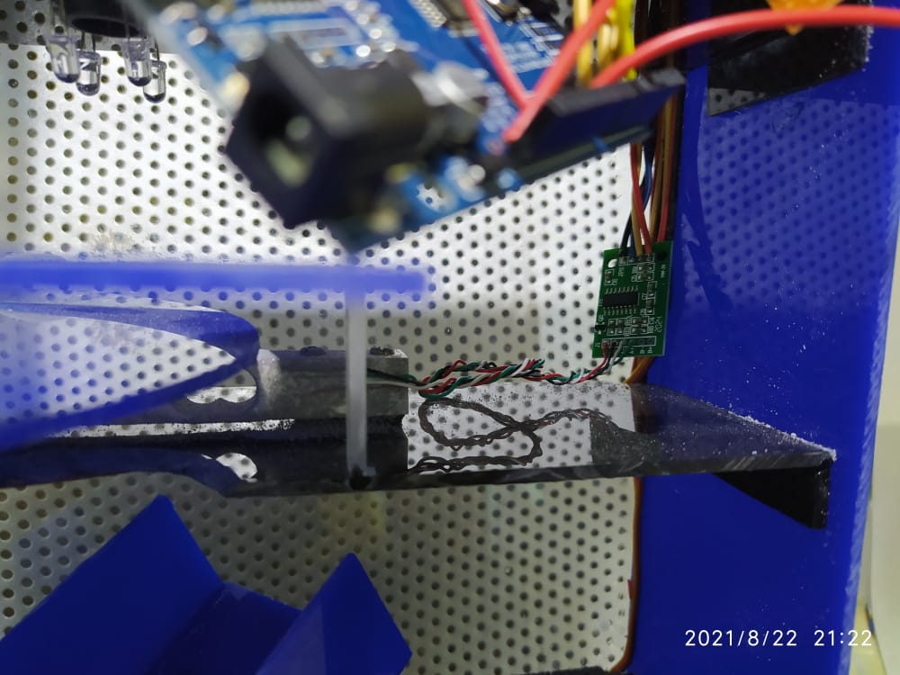
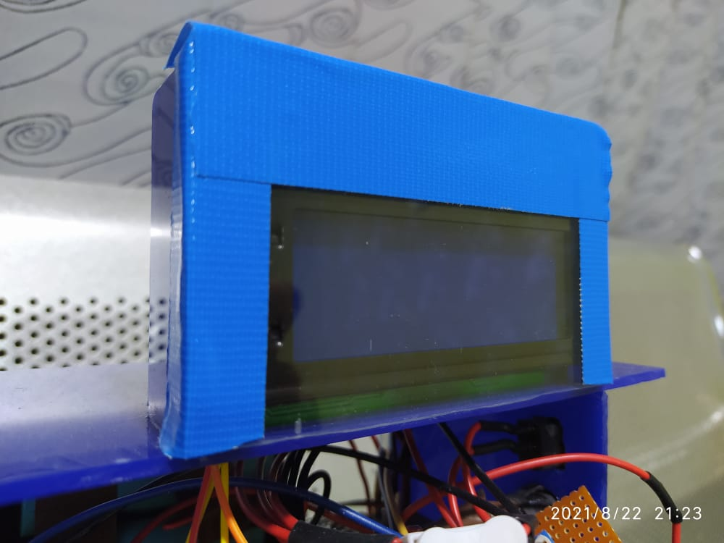
LED Display weight &quantity of products
Servo motors
Color Sensor

Slide 21
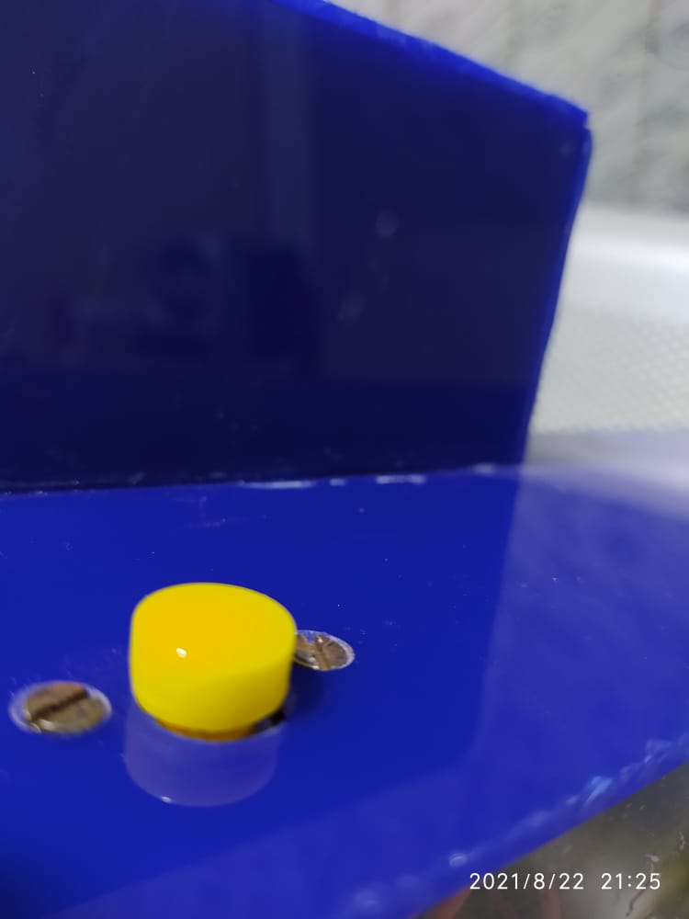
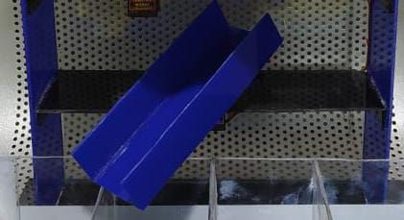
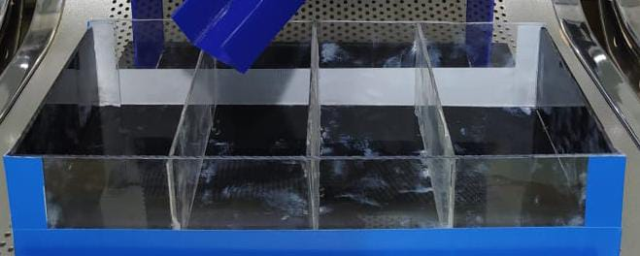
Containers
Reset Button
Throughout Objects in containers

Slide 22
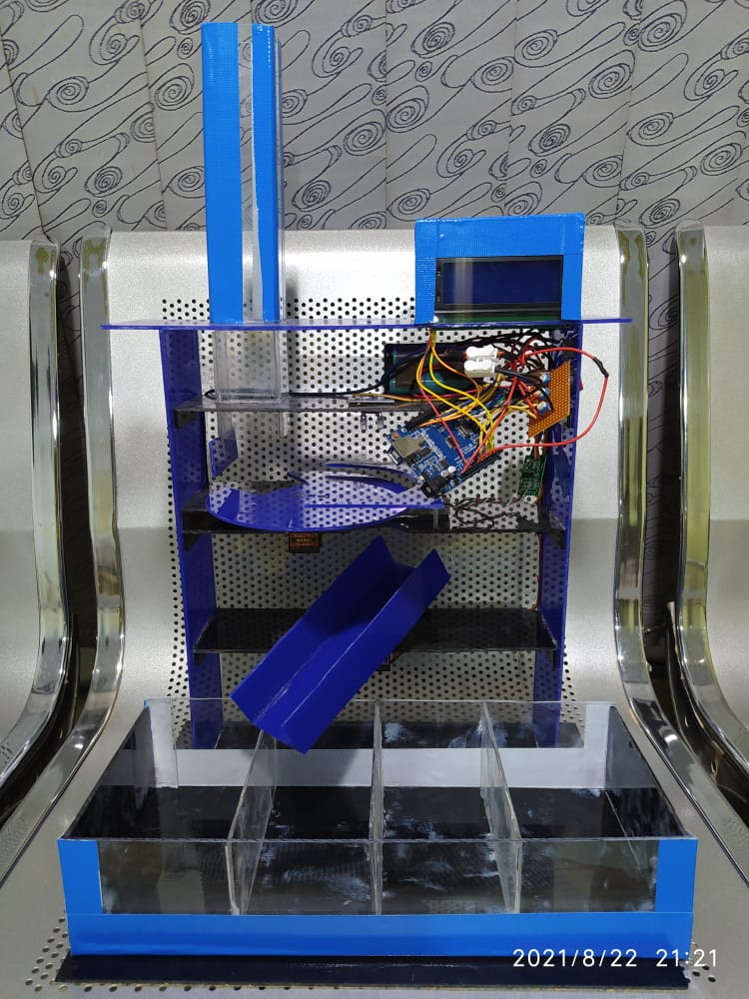
Complete Project Overview

Slide 23
Referencing

Slide 24
[1] R. Sharma, A. Agarwal and H. Mamatha, "IoT based sorting system of consumer goods production" 2021 Third International Conference on Intelligent Communication Technologies and Virtual Mobile Networks (ICICV), Tirunelveli, India, 2021, pp. 1407-1411, doi: 10.1109/ICICV50876.2021.9388520.
[2] D. Batra, H. Rewari and H. N, “Automate Fruits Sorting Machine" 2020 6th International Conference on Signal Processing and Communication (ICSC), Noida, India, 2020, pp. 206-210, doi: 10.1109/ICSC48311.2020.9182723.
[3] Prince Mary, S. Lakhsmi, Sareddi Vijaya, Anuhya Seemakurty (2019). Color Detection and Sorting Using Internet of Things Machine.
[4] S. Krishnakumar et al 2018 ‘Sensor based Color Sorting Robot for Candy Manufacturing’

Slide 25



Suggestions and Questions

Slide 26

PRESENTERS:- RIMSHA PERVAIZ (1307-2018) AISHA TABBASSUM (1318-2018)

